Slide 1
Anne Arundel County Public Schools
Technology Division
Presentation
April 2017

Slide 2
Technology Division Mission
The Division of Technology strives to provide excellent
customer service when delivering information, technology,
support and related resources to the students, teachers,
staff and the community of Anne Arundel County Public Schools
in the most efficient, effective, and equitable manner possible.

Slide 3
Technology Division Overview
Very large technology organization
Over 60,000 computing devices
Over 130 locations
Full wireless connectivity at all sites
Over 91,000 internal customers, more external customers
Almost everything done in AACPS uses technology in some manner

Slide 4
Technology Division Customers
  Students
  Teachers
  Parents
  Members of the Board of Education
  Superintendent
  Administrative and instructional support staff
  Anne Arundel County Health Department staff
  School Resource Officers (SRO) and Probation Officers
  Applicants for current job vacancies
  Maryland State Department of Education (MSDE)
  Federal agencies

Slide 5

Preparing Students for Their Future

Slide 6
Technology Organization Chart

Slide 7
Telecommunications and
Business Management Section
Telecommunications
    3,625 telephones
    904 cell phones
    65 pagers
    5,000 walkie-talkies
Technology Refresh – 17th year of implementation
    33,784 leased computers
      26,465 desktops
      7,319 laptops
Inventory
    Over 35,500 computers
      28,000 desktops
      7,500 laptops
      1,653 tablet devices
      5,068 classrooms
      5,100 printers
      328 copiers/multi-function devices
      3,094 interactive whiteboards
      5,519 data projectors
      3,553 document cameras
      1,948 wireless slate devices
      1,325 student handheld response systems
      4,990 handhelds (iPads, iPods)
      20,099 Chromebooks

Slide 8
Telecommunications and
Business Management Section
E-Rate
  Discount billing/reimbursements from communications vendors, Internet service, data circuits. Requested $1,696,000 in reimbursements in E-Rate year 2016
  School Construction/Smart Classrooms
  Installation of interactive white boards, mounted projectors, audio enhancement systems, document cameras and Vbrick Video Distribution Systems
    Kindergarten Additions – Odenton ES, West Meade ECC, North Glen ES, Woodside ES, Shady Side ES, Park ES, Brockbridge ES
    Open Space Enclosures – Brockbridge ES, Shady Side ES, Glen Burnie HS, Chesapeake HS
    Gym Additions – Woodside ES, Millersville ES
    New Construction - Crofton Area HS, Arnold ES, Odenton ES, George Cromwell ES, Highpoint ES, Jessup ES, Manor View ES,

Slide 9
Technology Operations Section
Computer Operations Group
Computer Operators
  Manage online systems
  Enterprise backup processes
  Setup and execute batch jobs and procedures
  Verify the success of unattended and overnight processes
  Large volume printing on high-speed printers
  Fold and seal large volume print jobs
  Monitor file server environments

Slide 10
Technology Operations Section
Network Services Group
Network Engineers
Design, build, maintain, manage, and secure the network infrastructure at more than 130 sites
  Data cabling
  LAN/WAN connectivity
  Comcast Business Class Internet
  I-Net build out
  Internet access
  Wireless access
  Firewall security
  Network design
  Network and cabling repair and maintenance

Slide 11
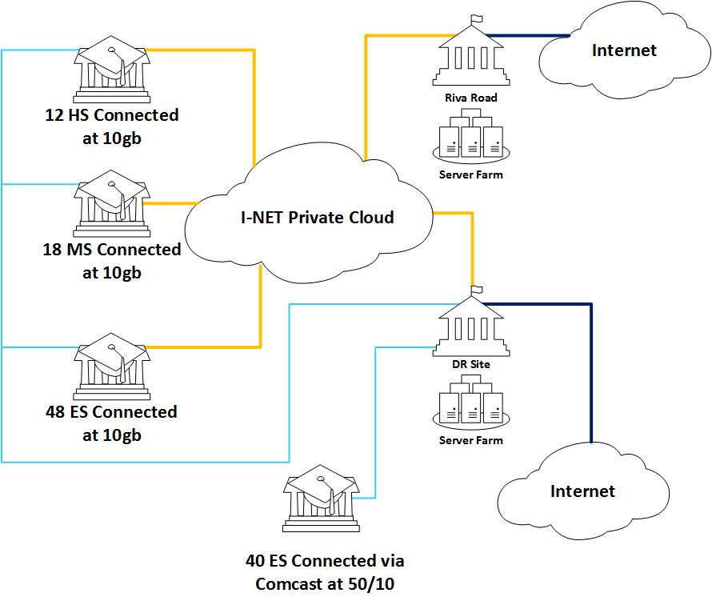
Network Topology

Slide 12
Information Security Section
Systems Administration Group
Systems Engineers
Build, maintain, manage, and secure over 800 file servers
  Application, database & web servers
      Custom applications
      E-mail
      Enterprise Resource Planning (Budget, Finance, HR, Purchasing, etc.)
      Identity Management
      Infrastructure
      Security & Anti-malware
      Student Data

Slide 13
Information Security Section
Systems Administration Group
Systems Engineers
Other Functions
  Backup and IT Disaster Recovery
  Desktop image development
  Enterprise Storage
  Hybrid cloud
  IT Security Investigations
  IT Security System Compliance
  PIA/FOIA Requests
  Project Management
  Tier III IT Support
  Virtualization

Slide 14
Applications Section
Design, develop, maintain and integrate over 60 administrative applications
Systems include:
  SMS Powerschool
  Power Teacher GradeBook and ParentCONNECTxp
  Blackboard Connect notification system
  Advantage HR and Advantage Financial
  Horizon OneSource
  Performance Matters
  Student Testing Information System
  SharePoint collaborative portal for schools and central office

Slide 16
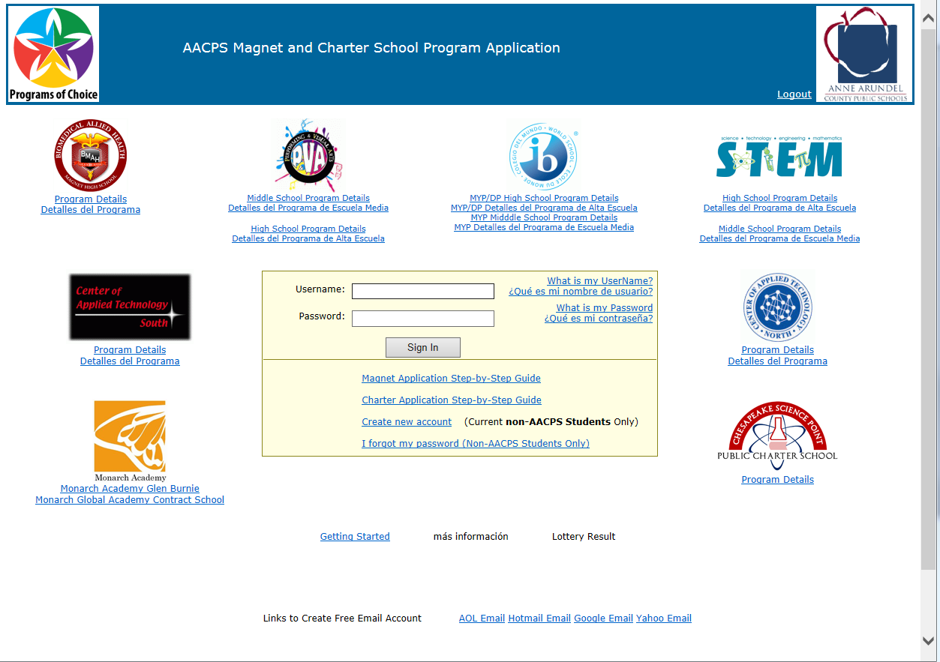
Magnet Application System

Slide 17
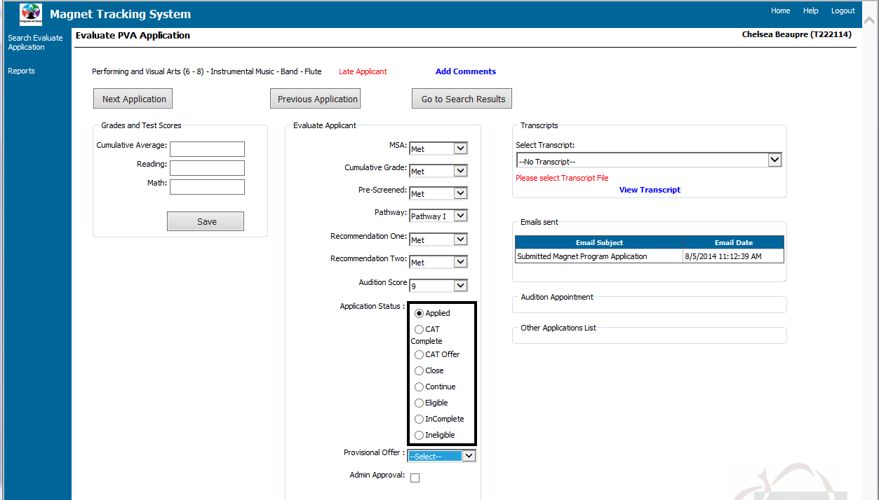
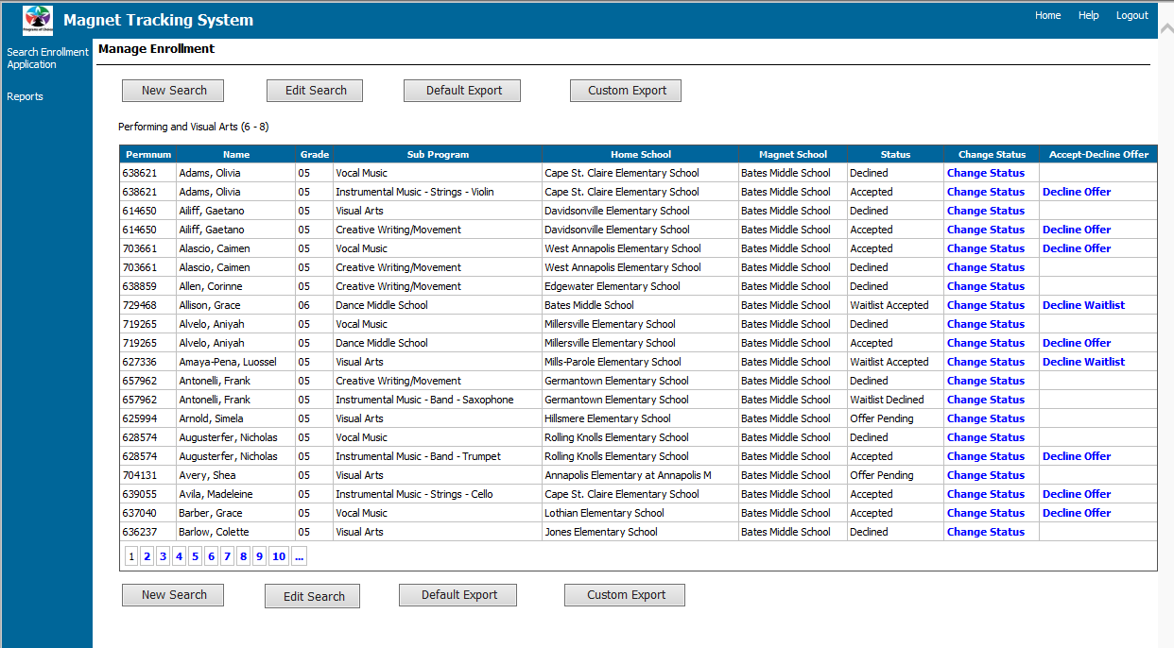
Magnet Tracking System

Slide 18
Applications Section
Current major projects for 2016-2017:
Budgeting software upgrade
Transportation routing software implementation
Food service software upgrade
Kinetics workflow system
Temporary employee payroll system
Oracle database server upgrades
Bus contractor pay system implementation
C5i upgrade to call-out system
Temporary employee time reporting system

Slide 19
The Project Management Group
New Initiatives
  Chromebooks for instruction: deployment & management
  Google Apps for Education Administration
  iPad Management & Apple Volume Purchasing Program
  Mobile Device Management System (Meraki)
Video Conferencing
  Implementation & training
Customer Service Support
  Assisting schools & departments with technology purchases, deployment & implementations
Notes:
Our group manages many projects for Technology and Technology related (other curriculum areas)
We are the starting point for new initiatives and pilots by researching, establishing processes & procedures for the smooth implementation of projects for AACPS users
New Initiatives: Chromebook deployment & managing our google Apps for Education, Mobile Device Management System (Meraki) to help manage our Apple Devices and Chromebooks, Apple Volume Purchasing Program implementation
Video Conferencing: training and maintaining Adobe Connect, for broadcast learning, meetings, hiring interviews, connections with other countries
Customer Service Support: Communication, Testing Office, Emerging Technologies, Curriculum Areas, Technology division areas, Meeting with schools to help plan their technology needs; construction/ renovations

Slide 20
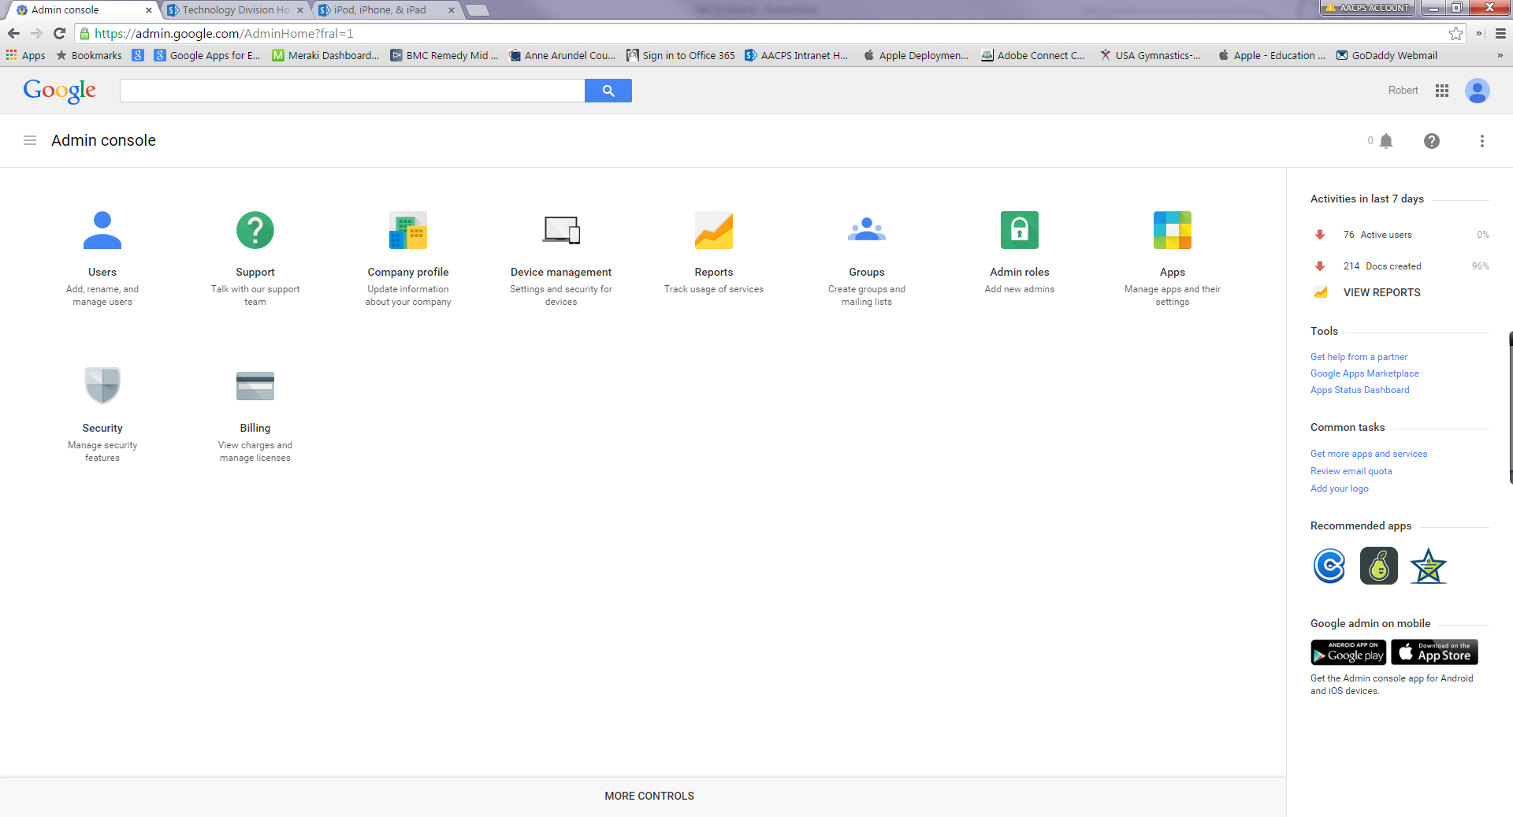
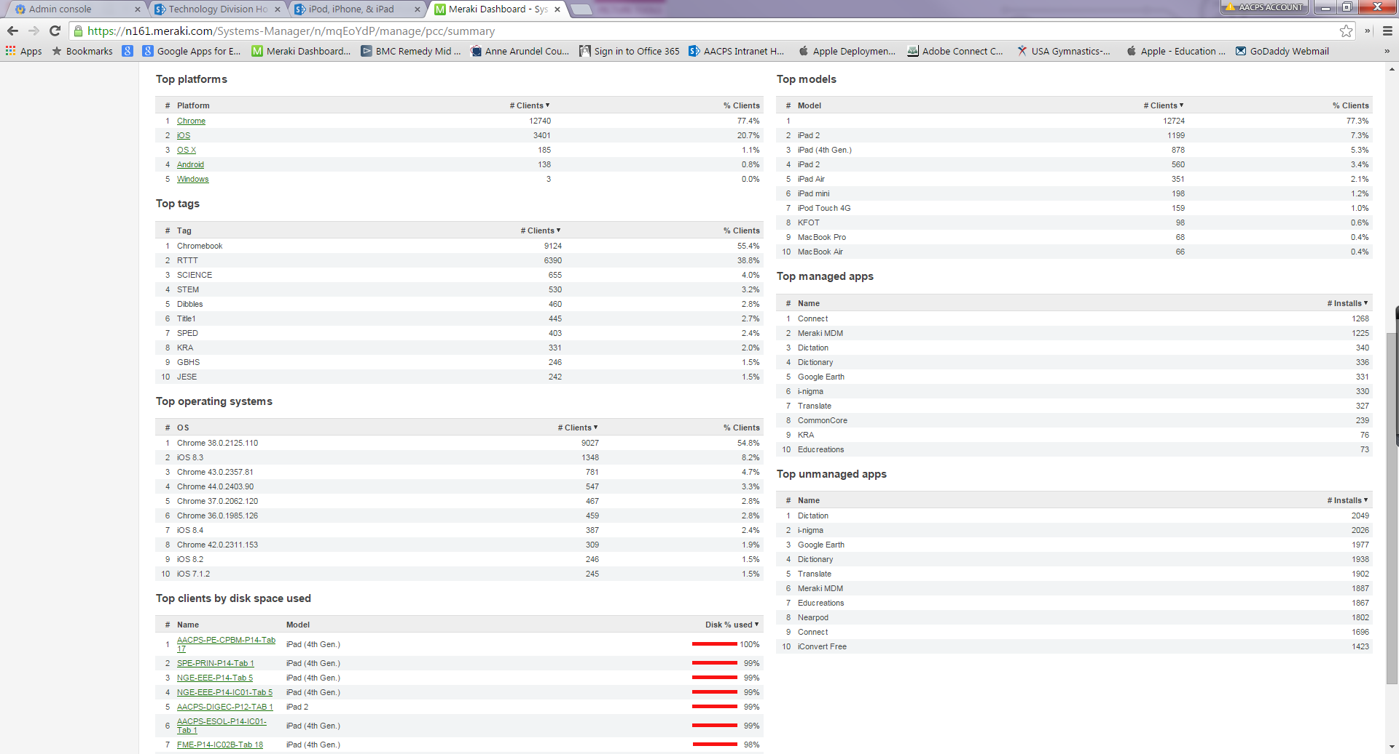
Google Apps for Education
Meraki (MDM)
Notes:
Chromebook #
7174 – Elementary Schools
2502 – Middle Schools
1866 – High Schools
329 – Admin
iPads
3396 – iPads on Meraki

Slide 21
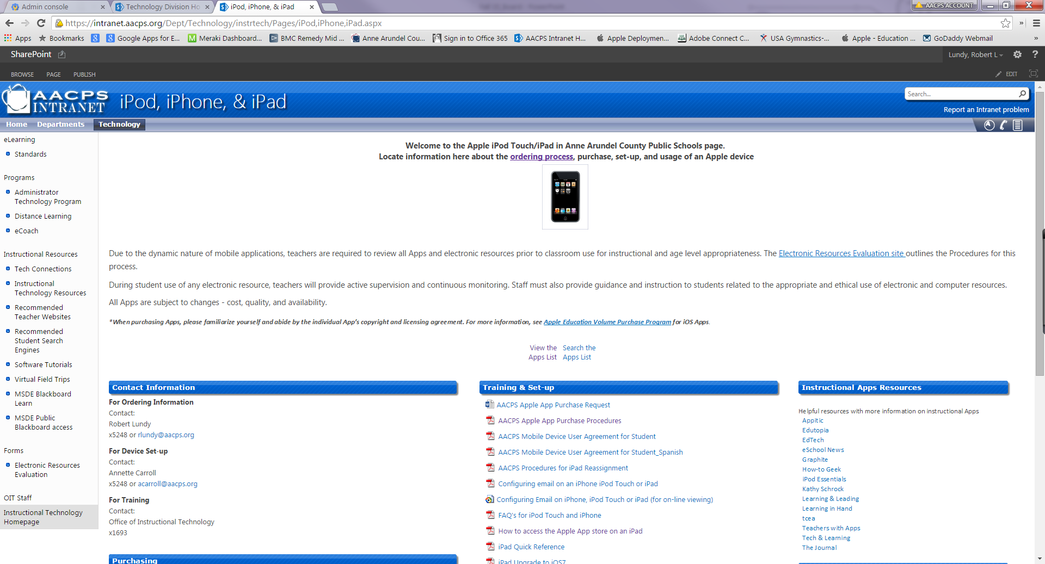
Notes:
Developed a page for information with a list of recommended Apps and purchasing devices

Slide 22
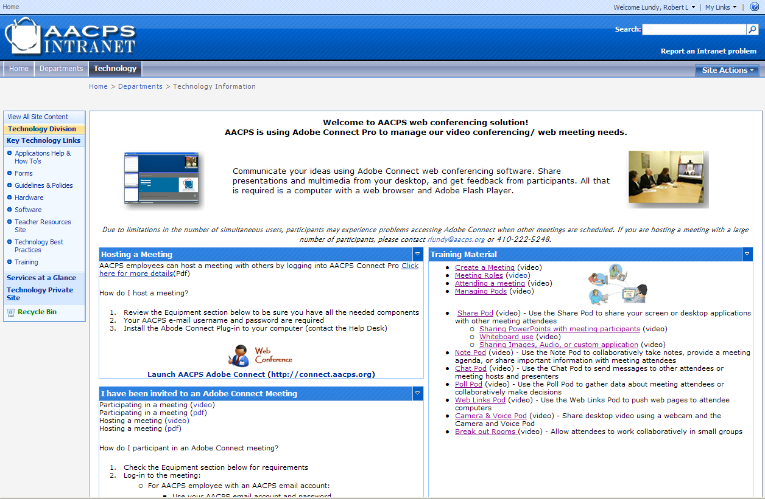
Notes:
Video conferencing training and online tutorial

Slide 23
Technology Support Services Section
Areas of Support
Instructional software applications
Administrative software applications
Online testing setup and support
Classroom technology support
Hardware diagnostics & repairs
User account management
LAN/WAN operability issues
Telecommunication operability issues
Business applications training
Small application development
Summer in-service technical support

Slide 24
Help Desk Calls
5 Year Trend

Slide 25
Help Desk Group
Business Applications Training
Active Directory
Adobe Professional
Adobe Captivate
Advantage Financial
Advantage HR
PowerSchool SMS
Blackboardconnect
MS Office 2010 / 2013
  Access
  Excel
  One Note
  PowerPoint
  Publisher
  Word
Office 365 / OneDrive
Outlook / OWA
Pacing guides
Remedy applications
SchoolBooks, School Funds Online
Smartboards
Horizon OneSource Food Services
Employee Self-Service
Kinetic Workflow Management

Slide 26
Help Desk Small Applications
Current Applications:
Help Desk Incident Tracking
Technology Equipment Repairs
Communication Center Incident Tracking
Superintendent Correspondence Tracking
HR Records Tracking
Technology / MOI Software Test
Special Ed Record of Assistance Tracking
Employee Investigations Tracking
Application Implementation:
Food Service Equipment Maintenance / Repair Tracking

Slide 27
Instructional Applications
Administration and Professional Development
SMART Technologies
Discovery Streaming Plus
WIMBA – audio tools used in Blackboard
Survey Monkey – online survey tool
Edmodo – safe and secure learning network
Google Apps for Education
Office 365 curriculum integration
Notes:
Discovery education – A multimedia teaching library of 160,000 learning objects designed for easy integration into the curriculum and correlated to the MD standards
Edmodo safe and secure learning network for students and staff receiving about 5,976 hits a day with over 49,923 students and 2,273 teachers

Slide 28
Current Technology Projects
Distance and Online Learning expansion
Data network infrastructure and wireless upgrades
Internet bandwidth upgrade
I-Net connection to all sites
Upgrade to TestNav 8.X
PARCC and other online testing support
Infusion of emerging classroom technologies
Microsoft Windows 10 and Office 2013
Microsoft Office 365 and OneDrive for students and employees
Technology Refresh project
Network Access Control
Chromebooks
Kinetic workflow software implementation
Transportation routing software implementation
IT Security vulnerability and penetration testing
Sensitive system at rest encryption

Slide 29
Anne Arundel County Public Schools
Technology Division
Thank you

